Slide 1
BUILDING THE VIRTUAL ASSISTANT FOR TRAVEL PLANNER
SAI VENKATA ARAVIND BANDHANADAM (811180445)

Slide 2
INTRODUCTION
The Pandemic had made everything online/digital to avoid Physical distance/ Human Contact.
Digital Process is new to many people, They have of lot of queries related to working of applications, Organizations hire people for customer support but increasing no of customers, customer support/executive are unable to handle hundreds of people at a time.
So most of the people’s queries remained unsolved.
Here comes Virtual Assistant into picture.

Slide 3
PROJECT OVERVIEW
Virtual Assistant implentation using Convolutional Neural Network (CNN) for Travel Planner.
Collecting Data from different Resources.
Implementing Virtual Assistant for Travel Planner:
Showing Categories of places (Hill Stations, Waterfalls).
Selecting State for vacation.
Displaying basic journey details (Travel duration, Mode of Transport, Cost).
Opting for mode of transport based on their interest.
Integrating this model with web-application.

Slide 4
PROJECT STEPS
PROJECT STEPS | PROJECT OBJECTIVE DESCRIPTION
STEP 1 | Understanding Virtual Assistant working.
STEP 2 | Understanding Speech recognition, Text to Speech, Speech to Text Conversion.
STEP 3 | Data Collection and Manipulation.
STEP 4 | Writing Code for Entire Project. Training and Testing the model.
STEP 5 | Integrating with Web-Application

Slide 5
Problem statement
Organisations are spending huge amount on customer support, Customer Service and still unable to resolve all the queries of Users efficiently.
Virtual Assistant would reduce the amount spent, work pressure on Customer Support and also enhances User experience.

Slide 6
Motivation
A crazy Tourist, Start-up (Yet to be recognized).
It is a start-up they plan trips based on customer interest, As they are a start-up hiring customer support is not possible.
My Virtual Assistant would be useful in guiding the customers to select their trip based on their interest/requirement.

Slide 7
THE AIM OF THIS PROJECT IS TO:
To build Virtual Assistant that answers the queries of the users.
Implementing Virtual Assistant for Travel Planner
Integrating model with the web-application.
This Virtual Assistant will be accepting the input as text or speech,
To accept speech as input I will be using system microphone, Speech recognition (Python Library).
Later using Speech-to-Text conversion technique (Provided by Speech recognition library),
Speech input is converted into text and processed.

Slide 8

OBJECTIVES OF THE PROJECT
To enable user input in both text and speech/voice.
1
To Display output based on user requirement (text only).
2
To Answer maximum number of possible queries.
3
Building Virtual Assistant for Travel Planner.
4
To Integrate Model with web-application.
5

Slide 9

OBJECTIVE 1: To Enable user input
Virtual Assistant will be accepting the input as text or speech, To accept speech as input i will be using system microphone, Speech recognition (Python Library).
Later using Speech-to-Text conversion technique (Provided by Speech recognition library), Speech input is converted into text and processed.

Slide 10


OBJECTIVE 2: TO DISPLAY OUTPUT(text or speech)
Output will be displayed based on user input. When user enters the place name CNN model checks with the data-set and compares the input with intents and shows the matching result as output.

Slide 11



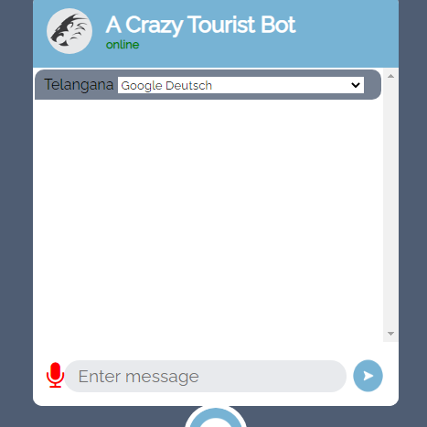
Objective 3: To integrate model with web-application
I built web-application using HTML,CSS, Java Script, Bootstrap and using the Flask integrated my model with web-application.

Slide 12
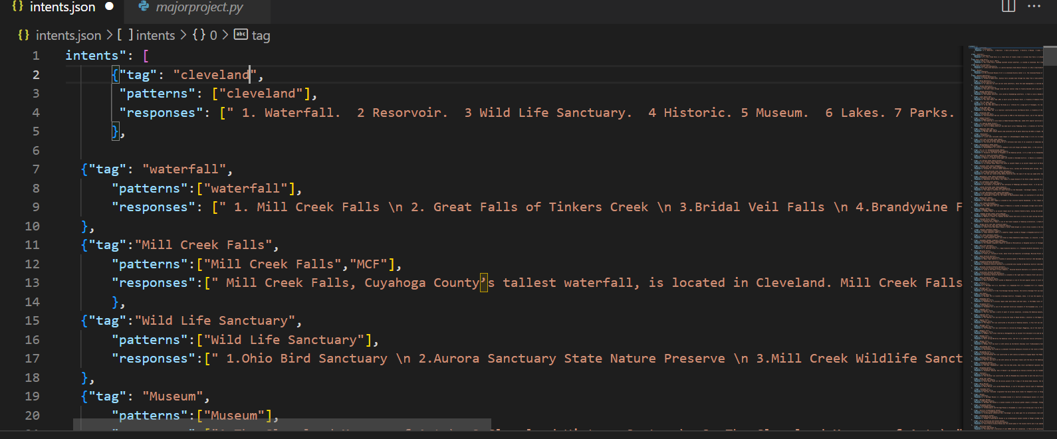
DATA SET

Slide 13
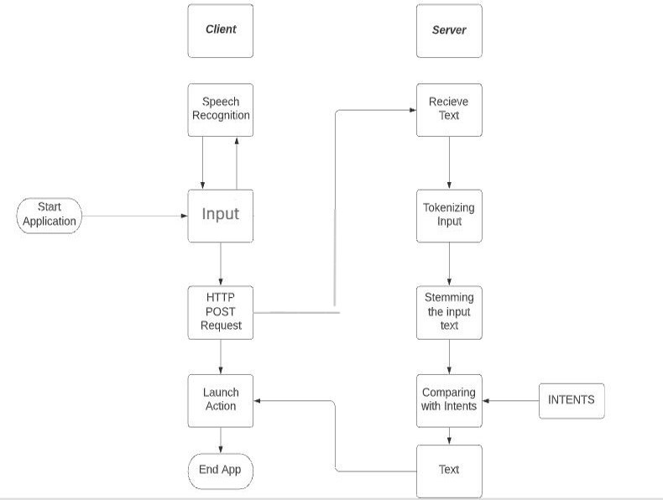
BLOCK DIAGRAM OF THE PROJECT

Slide 14
SOFTWARE(s) USED IN THE PROJECT
Python
PANDAS
NUMPY
Speech Recognition
Natural Language Processing (NLP)
Convolutional Neural Network (CNN)
Tools Used:
Google Collab.
Vs CODE
Python IDLE

Slide 15
RESULT
RESPONSE TIME: 0.0173ms
LATENCY: 0.009ms
Input to Output | RS1 | RS2 | RS3 | LATENCY
Text to Text | 0.018ms | 0.015ms | 0.019ms | 0.009ms
Speech to Speech | 0.018ms | 0.015ms | 0.019ms | 0.009ms

Slide 16
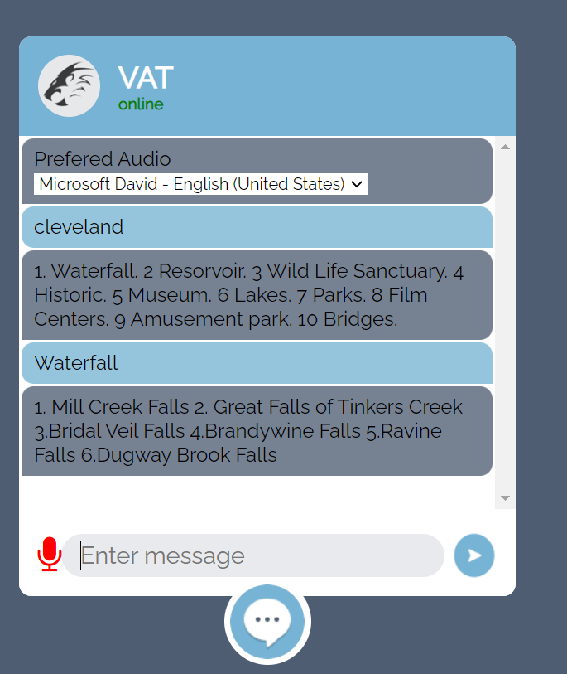
SNAP SHOT OF THE RESULT

Slide 17
CONCLUSION AND FUTURE SCOPE
Virtual Assistant reduces human effort by responding to the queries asked by users. When Virtual Assistant is powered by a deep learning algorithm called Convolutional Neural Network it gives a good response.
CNN model is trained with a data-set consisting of 85 most visited places in cleveland whenever a user enters the place name my model processes the data and fetches the result from the data-set.
By adding the Images and videos of the respective places,We can enhance the user experience.
Using the API of Google maps,we can integrate maps with my model and we can show directions and review of the places on my webpage itself
This can also be used for educational purposes,And Entertainment Purposes.

Slide 18
Applications
E COMMERCE CINEMA MEDICAL ONLINE GROCERY

Slide 19
references
[1] Dr. M. Sharada Varalakshmi, Jarvis - A Virtual Assistant based on Artificial Intelligence, International Journal of Grid and Distributed Computing Vol. 13, No. 2, (2020), pp. 776 – 784
[2] Yogendra Kumar Shar m a , A Review Paper on Smart Personal Assistant, International Journal of Engineering Research & Technology (IJERT) ISSN: 2278-0181 Published by, www.ijert.org V-IMPACT - 2016_2 Conference Proceedings
[3] Hephzibah Thomas , Critical Literature Review on Chatbots in Education , International Journal of Trend in Scientific Research and Development (IJTSRD) Volume 4 Issue 6, September-October 2020 Available Online: www.ijtsrd.com e-ISSN: 2456 – 6470
[4] Vani Valsaraj, Implementation of Virtual Assistant with Sign Language using Deep Learning and TensorFlow, International Journal for Research in Applied Science & Engineering Technology (IJRASET) ISSN: 2321-9653; IC Value: 45.98; SJ Impact Factor: 7.429 Volume 9 Issue I Jan 2021- Available at www.ijraset.com

Slide 20
references
[5] The Alexafication of Adult Social Care: Virtual Assistants and the Changing Role of Local Government in England, International Journal of Environmental Research and Public Health
[6] Nanaware, Rasika. “Chatbot for Education System.”, Corpus ID: 58318311, (2018).
[7] Clarizia F., Colace F., Lombardi M., Pascale F., Santaniello D. (2018) Chatbot: An Education Support System for Student .

